Slide 1
Elections in Ohio – Party loyalty and Brands

Slide 2
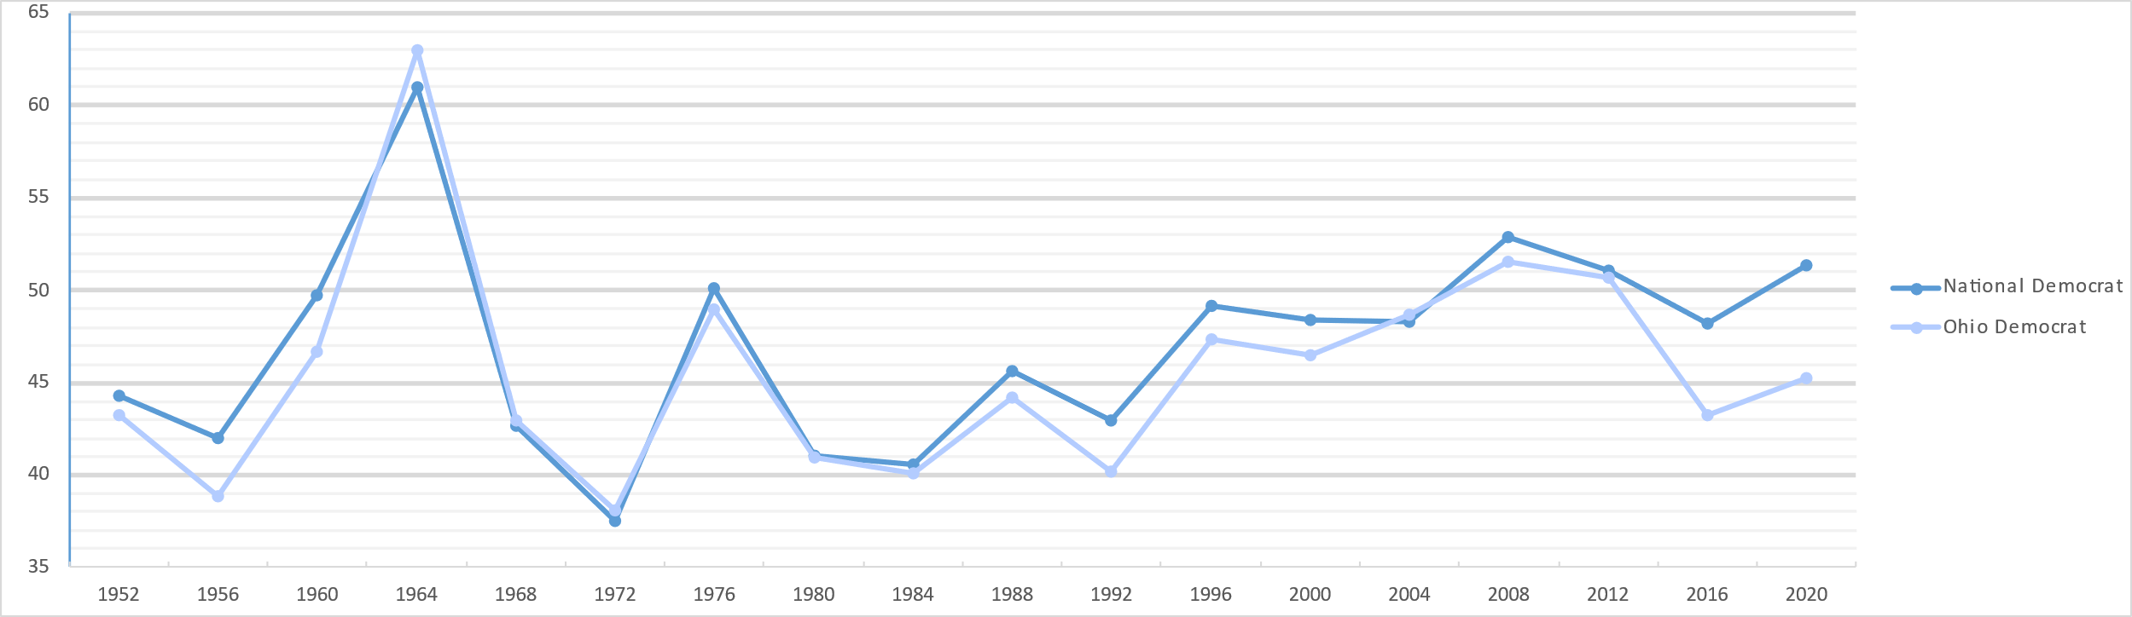
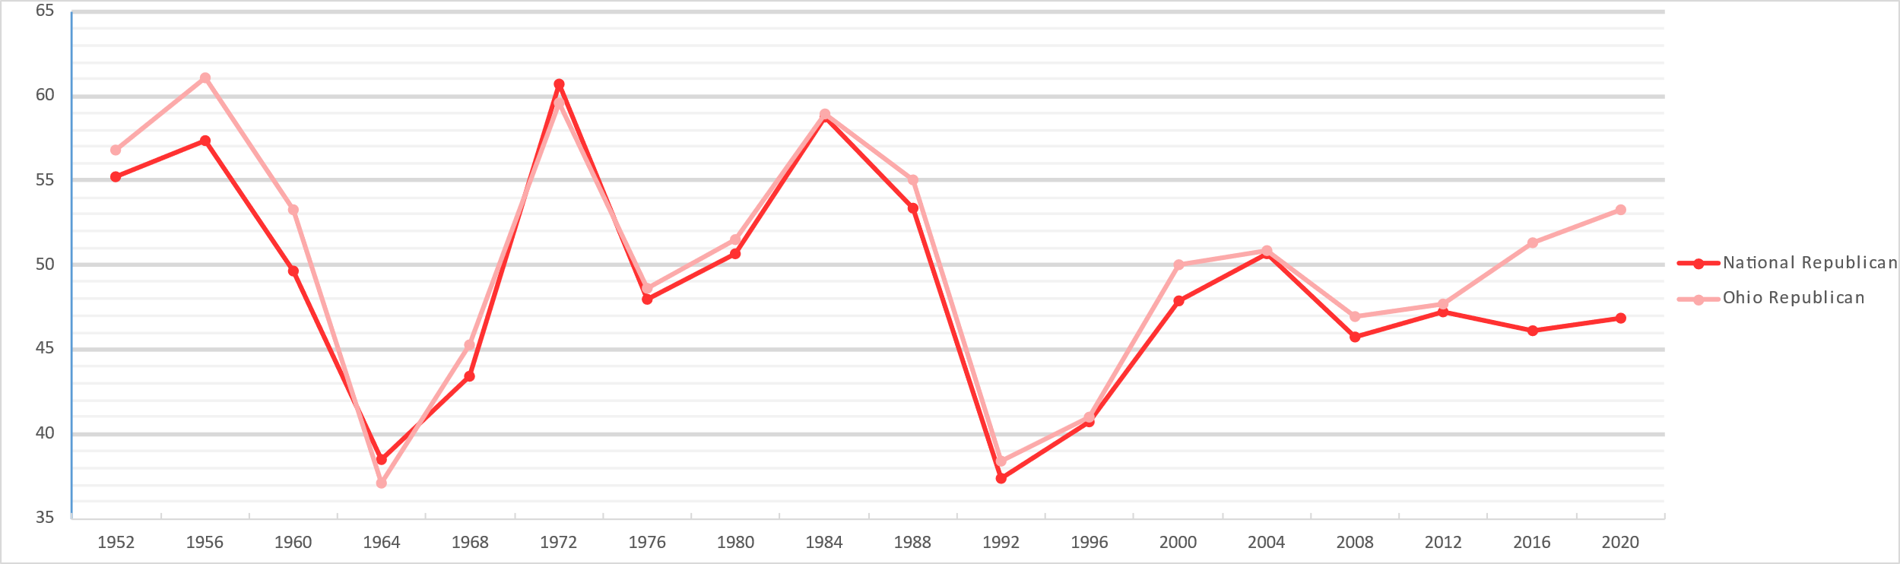
1. Take note of how the support for a presidential candidate in Ohio is nearly identical to that candidate’s national support!
2. Take note of how G. Bush Sr. performed much worse in his second election (1992) , without the democrat (Bill Clinton) improving on the performance om M. Dukakis. This is due to the massive amount of voters for independent R Perot. Looking at the performance of 3rd party candidates in the excel sheet, even 3rd party candidates seem to follow the national average.
3. Take note of how Ohio has gotten more republican than the national average, starting between 2012 and 2016.

Slide 3
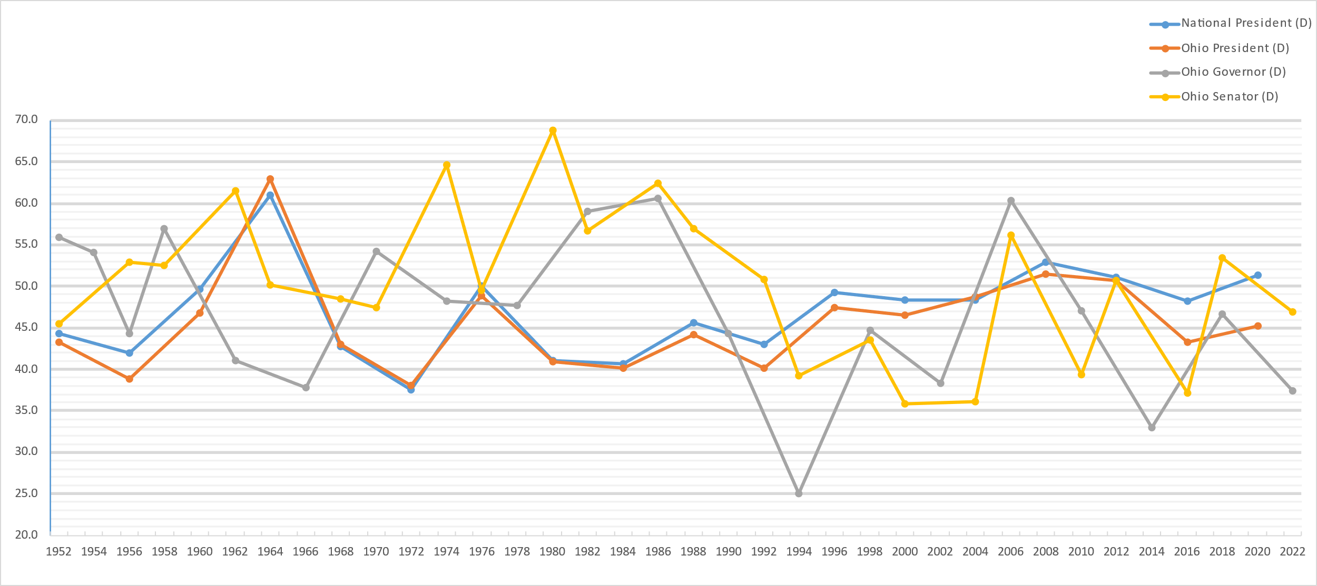
Democratic Candidates
4. We see that the percentage of votes for Governor /Senator can vary wildly, and does not track with President! Voters are NOT just loyal to a party
5. We take note of Sen. Sherrod Brown (D, 2006, 2012, 2018) who regularly outperforms other democratic nominees for Senator (2004, 2010, 2016, 2022). Voters are not just loyal to a party!

Slide 4
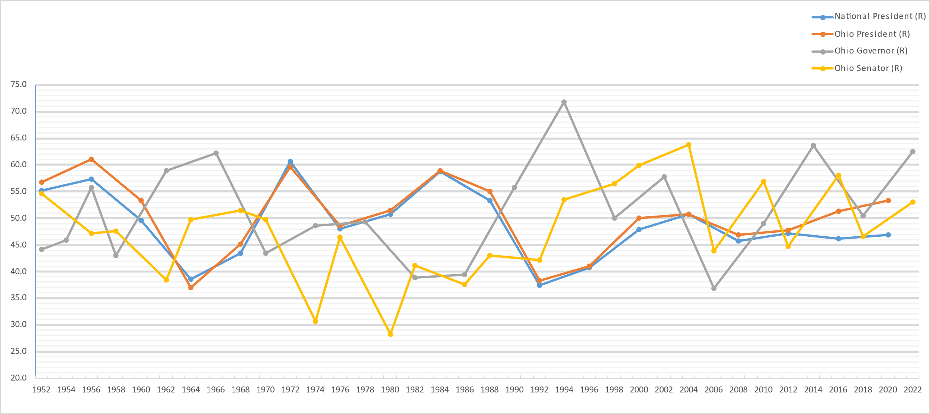
Republican Candidates
6. We can make many of the same conclusions her, but there is a red herring! One might think, upon seeing the data that Senator 2004, 2010, 2016 and 2022 was the same candidate that managed to create a brand for him/her self, but this is really three different candidates. Always think twice before concluding!

Slide 5
Summary
Making a Brand and outperforming other members of the party is entirely possible.
Voters are not just loyal to a party.
The myth that Ohio votes the same way as the country generally held true, but only until 2016.
Extra notes:
Most of the data is taken from Wikipedia. The data for total voters for gubernatorial candidates might not be exactly accurate, but close enough. This presentation was made by Odd Harald Sandtveit.

